Slide 1
INDONESIA’S SCHOOL OPERATIONAL ASSISTANCE PROGRAM (BOS): CHALLENGES IN EMBEDDING RESULTS-BASED APPROACHES
Prof. Suyanto, Ph.D.
(Department of Economics Education, Faculty of Economics, Yogyakarta State University
(suyan@ymail.com)
27th ICSEI (International Congress for School Effectiveness and Improvement)
Redefining Education, Learning, and Teaching in the 21st Century: The Past, Present and Future of Sustainable School Effectiveness. Yogyakarta, Indonesia, 2 – 7 January 2014.
1

Slide 2
Moving from centralized to decentralized education systems: a paradigm shift
.
 | Centralized | Decentralized
Planning | Top-down: Ministry of Education and Culture | Bottom-up: Participatory
Budgeting | National budget: Line Ministries | Local Government Budget: (Province, District)
Implementing | MoEC authority | Local Government School Based Management
Monitoring and Evaluation | Central, formal processes | Central Local government Community oversight

Slide 3
Indonesia’s School Operational Grants (Bantuan Operasional Sekolah – BOS)
BOS Block Grants provide stimulus budget for achieving quality 9-year compulsory education in Indonesia.
BOS provides subsidiary funds to finance the cost of school operations for all public and private schools.
BOS provides support for poor households to finance individual student costs, to some extent.
3
Notes:
Uniforms, shoes, books, transportation, school supplies (stationery)

Slide 4
BOS Objectives
BOS reduces the financial burden of education on parents, in the
framework of quality 9-year compulsory education.
Particular objectives:
To free all poor students at basic education level from the burden of school operational costs, at public and private schools.
To free all students of public primary schools and public junior high schools from school operational costs, except those of pre-international standard schools and international standard schools.
To lighten the burden of school operational costs on private school students.
4

Slide 5
Quality 9-year Basic Education for All: a national priority
Transformative: centralized system to one supporting School-Based Management
Block grants to schools: most important source of funds under school control.
Shifts responsibility for planning and managing operations to schools based on student needs.
Increases transparency and accountability by involving beneficiaries and the community to improve education quality.
Financial burden reduced for the public.
Poor households freed from school fees.
Notes:
School Based Management
Transformative: from a centralized system to one supporting School-Based management
Most important source of funds under school control
Shifts responsibility for planning and managing school operations to schools.
Increases transparency and accountability by involving beneficiaries.
SBM empowers schools and teachers.

Slide 6
The BOS Journey: 2005 to 2013
2013
33 million students
US$ 0.45 billion (Semester 2)
US$ 26 per primary student/year
US$ 36 per Junior Secondary student/year
36.6 million students
US$ 2.05 billion
mid-2005
US$ 50.09 per primary student/year
US$ 61.83 per Junior Secondary student/year
Note: US$ rate as of before 2013: IDR 9,000
US$ rate as of December 2013: IDR 11,500
Notes:
BOS Eligible Expenditures:
Purchase/reproduction of textbooks
Activities in new enrollments (registration fee, reproduction of forms)
Active Learning and extracurricular activities
Tests and Examinations
Purchase of consumables (notebooks, chalks, pencils, marker pens, paper, newspapers, scientific and literature magazines)
Utilities (electricity, water and telephone, internet)
School maintenance (painting, repair of leaking roofs, repair of doors)
Payments of honoraria for temporary teachers and education personnel
Teaching Profession Development (transport and teaching aids)
Contributions to poor students (transport, uniforms, shoes and stationery)
BOS management financing (stationery: printer ink, CD and flash-disk; duplication; correspondence)
Purchase of set of computers
Other expenses: audiovisual aid/learning media , typewriters.

Slide 7
The BOS Journey 2005 - 2013
 | 2005 | 2006 | 2007 | 2008 | 2009 | 2010 | 2011 | 2012 | 2013
No. Students (million) | 32.9 | 33.6 | 35.2 | 35.9 | 36.2 | 36.5 | 36.6 | 36.6 | 36.6
Primary School -Unit Cost (US$) | 26 | 26 | 28 | 28 | 44 | 44 | 44 | 64 | 50.09
Junior Secondary School - Unit Cost (US$) | 36 | 36 | 39 | 39 | 63 | 63 | 63 | 79 | 61.83
Total Budget (billion US$) | 0.45 | 0.92 | 1.09 | 1.12 | 1.78 | 1.79 | 1.80 | 2.6 | 2.05
Note: 1. BOS commenced in Semester 2, 2005;
2. Unit Costs are per student/year;
3. US$ rate as of before 2013: IDR 9,000
4. US$ rate as of December 2013: IDR 11,500

Slide 8
BOS Scope and Unit Costs in 2013
Scope:
Primary and Junior High schools (public and private) throughout Indonesia: 33 provinces with 497 districts and 181,000 schools.
Unit Costs:
Calculated on the basis of number of students enrolled:
Primary: US$ 50.09/student/year
Junior High: US$ 61.83/student/year
Note: US$ rate as of December 2013: IDR 11,500
8
Notes:
BOS is also provided by MoRA using the centralized system.

Slide 9
BOS Budget Allocations: 2013
Level | No. Schools | No. Students | Total Budget (US$)
Elementary Schools | 147,491 | 27,153,667 | 1,369,489,290
Junior High Schools | 33,669 | 9,425,336 | 581,912,048.3
Buffer Fund |  |  | 100,320,398.6
TOTAL | 181,160 | 36,579,003 | 2,051,721,737
Note: US$ rate as of December 2013: IDR 11,500
Notes:
Note: MoEC and MoRA BOS funding represents around 8.9% of the national Education Budget (note National education budget is 20% of the state budget)
Include information on percentages compared with overall education and national budget

Slide 10
Ensuring accountable and transparent fund use
BOS control systems are embedded
Policy and Procedural Guidelines/Manual
BOS Management Implementation Mechanisms: Central, Provincial, District, School
Parental and Community Oversight
Monitoring and Evaluation at all levels: central, provincial, district, school levels
On line reporting of fund use by schools through www.bos.kemdikbud.go.id
Audits: Supreme Audit Agency, National Supervision and Audit Agency, Corruption Eradication Commission, Central and Local Inspectorates
Complaint handling systems
10

Slide 11
BOS Policy and Procedural Guidelines
Explicit procedures are detailed
Student enrolment data.
School Development and Budget Plans.
BOS fund flow mechanism.
BOS fund use (eligible and ineligible expenditure categories).
BOS Management Team roles and responsibilities: Central, Provincial, District and School levels.
Parental and School Committee involvement and participation in decision making.
Monitoring and evaluation requirements: Central, Provincial, District BOS management teams.
Transparent and accountable school reporting.

Slide 12
BOS fund use: eligible categories
1 | Library: books purchase/reproduction
2 | New enrolment activities: registration fee, reproduction of forms.
3 | Active Learning and extracurricular activities.
4 | Tests and Examinations.
5 | Purchase of consumables (notebooks, chalks, pencils, marker pens, paper, newspapers, scientific and literature magazines).
6 | Utilities (electricity, water and telephone, internet).
7 | School maintenance (painting, repair of leaking roofs, repair of doors).
8 | Payments of honoraria for temporary teachers and education personnel.
9 | Teaching Professional Development (transport and teaching aids).
10 | Contributions to poor students (transport, uniforms, shoes and stationery).
11 | BOS management financing (stationery: printer ink, CD and flash-disk; duplication; correspondence).
12 | Purchase of computers.
13 | Other expenses of components 1 to 12 (Audiovisual aid/learning media, typewriters).

Slide 13
BOS Implementation Mechanisms
Fund Channeling:
Transferred quarterly (beginning Jan, April, July, Oct). For remote schools transferred every smester
Transferred from province direct to school bank account
Schools withdraw and use BOS funds as required
3
National
2
Provincial
District
1. Data Collecting Process
2. Socialization and Training
1
School
3. Fund Channeling
4
4. Reporting
13

Slide 14
School responsibilities
Verify that funds received are based on the number of students enrolled.
Use transparent and accountable school-based management to manage BOS funds:
Conduct school self-evaluation to improve education quality.
Prepare school plans developed using participative school planning processes, based on local needs:
- 4-year plan specifying goals for quality improvement.
- Annual plan specifying the managerial action plan.
- Budget plan
- Quarterly expenditure reports
Post a summary report on the use of funds on publicly accessible school notice-boards.
14

Slide 15
Parental and Community Oversight
Plan
Report
TV
Dos Don’ts
Procurement
School Notice Boards
School Meetings
Print Media
TV and Radio
Notes:
Empower parents with knowledge of BOS. What is their right? What can they ask for?
Technical Assistance from Development Partners
A national television and print media campaign targeting the general public across the whole of Indonesia. The aim of the campaign was to provide basic BOS information and advocate for greater transparency using public service announcements on television and print advertorials.
Parents included in the evaluation were randomly selected to receive a set of SMS messages providing information on BOS.
School meetings were convened by the principal or a community leader to improve parental knowledge of BOS and participation in school affairs. x
New colorful BOS notice boards were provided to schools participating in the evaluation to improve parental knowledge of BOS and school operations.

Slide 16
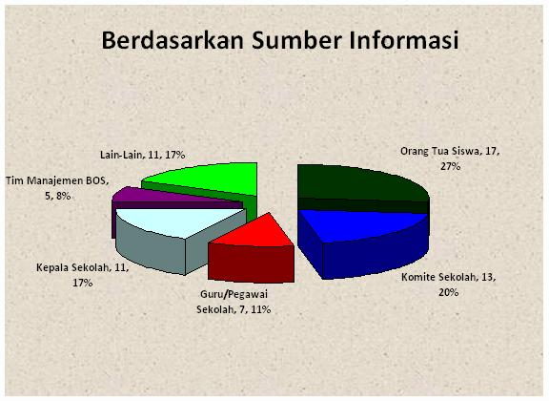
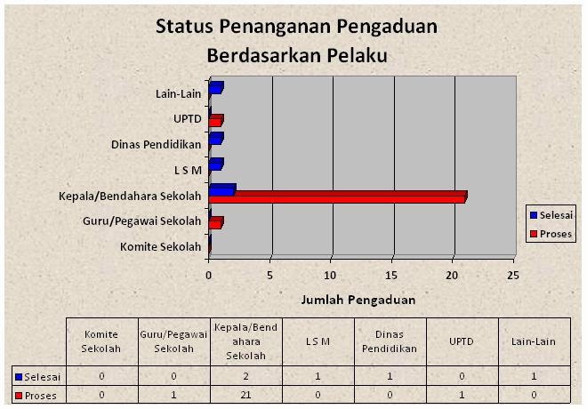
E-Complaint Handling System
(www.bos.kemdikbud.go.id)
COMPLAINT ON-LINE
SMS (1771)
SERVER APPLICATION BOS MANAGEMENT
COMPLAINT REPORT
INPUT
BOS Management Teams: Central, Province and District
Telephone, newspaper, letters, email, direct visit
HANDLING SYSTEM
Next Page….

Slide 17
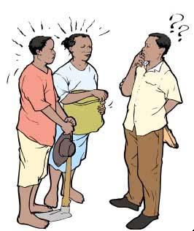
Complaint Handling System
2b. Clarify & Investigate
3. Analyze and Handle
1. Record
Complaint
Question
4. Monitor progress and evaluate
5a. Sanction
2a. Direct Response
5b. Warning
6. Disseminate to Public
5c. Reward
RECORD & REPORT
HANDLE

Slide 18
Perceptions about the the impact of BOS
[Respondents: District Heads, Principals, Teachers, School Committee members]
BOS Impact | Region (percentage of opinion)
 | Sumatera | Java | Bali | Kalimantan | Sulawesi | Maluku | Papua
Lower dropout rates | 76% | 74% | 81% | 74% | 80% | 54% | 50%
Higher student transition to Junior Secondary School | 89% | 90% | 81% | 87% | 91% | 86% | 74%
Less fundraising by schools | 63% | 62% | 62% | 58% | 61% | 40% | 41%
Higher enrolment of poor students | 69% | 63% | 74% | 60% | 75% | 48% | 68%
Increased availability of text books | 91% | 94% | 94% | 87% | 94% | 80% | 50%
Increased school authority | 73% | 76% | 79% | 72% | 75% | 69% | 56%
Higher student performance | 88% | 90% | 92% | 80% | 97% | 81% | 81%
SOURCE: School Based Management National Survey, World Bank (2010)
Notes:
Percentages constructed by taking the average across district head, school principal, SC head, SC member and teachers in school (equally weighted). * Mean is significantly different at 0.01 level; ** Mean is significantly different at 0.05 level. Data are weighted. SOURCE: World Bank, SBM National Survey

Slide 19
Moving forward………
Planning | Extending BOS to Senior High Schools and Higher Education. Synergized policy for education management and governance at sub-national level. Strengthening SBM to improve the quality of education outcomes and school governance. Reviewing school financing requirements: Education Unit Costs, BOS Unit Costs.
Budgeting | Developing and implementing a formula-based national BOS allocation on the basis of fairness and equity. Establishing incentives for district financing to meet Minimum Service Standards in Education. Encouraging districts to allocate counterpart funds (BOSDA) on the basis of access, equity and performance improvement.

Slide 20
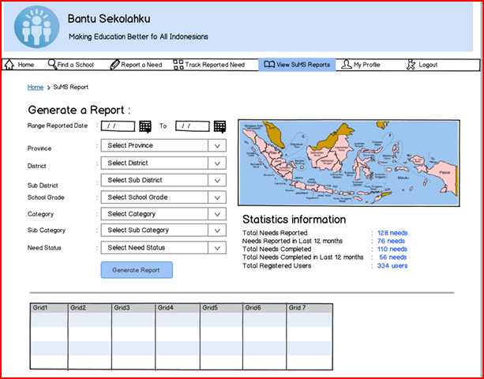
Moving forward…………
Implementing | Building district-level capacity and capability for results-oriented management Financial management capacity and capability building for Principals and Treasurers Increased parental and community oversight
Monitoring and Evaluation | Valid and reliable data collection: by school and by student name 2. Reporting on school needs: the Support My School web-based platform 3. Continuous improvement: - E-Monitoring - E-Complaint Handling

Slide 21
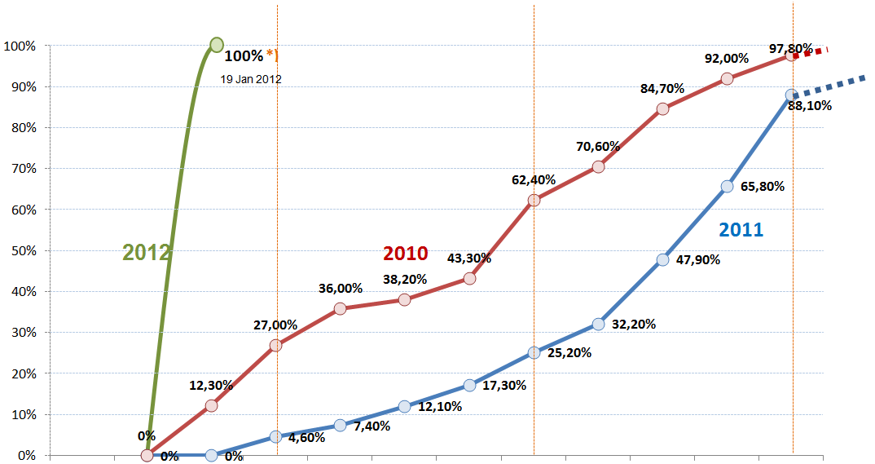
Comparison of BOS disbursments: 2010, 2011, dan 2012
The First Quarter
The first month
The second month
The third month
Focusing on technical assistance of BOS spending and accountability
Week - 1
Week - 2
Week - 3
Week - 4
Week - 1
Week - 2
Week - 3
Week - 4
Week - 1
Week - 2
Week - 3
Week - 4

Slide 22
THANK YOU FOR YOUR ATTENTION
TERIMA KASIH

